Slide 1
TELECOM CHURN CASE STUDY Partner 1. Dipali Gurnule 2. Natasha 3. Bhargav Sai

Slide 2
PROBLEM STATEMENT & OBJECTIVE
The telecommunications industry experiences high levels of customer churn, with an average annual churn rate of 15-25%. Given that acquiring new customers is more expensive than retaining existing ones, telecom companies need to identify those customers who are at high risk of churning.
In this project, the customer-level data of a leading telecom firm will be analyzed to build predictive models that can identify high-risk customers and the main indicators of churn. The project will focus on the Indian and Southeast Asian market where the prepaid payment model is most common. Churn will be defined as usage-based, i.e. customers who have not engaged in any usage, incoming or outgoing, in terms of calls or internet for a certain period of time.
The focus will be on reducing the churn of high-value customers, defined as those who generate 80% of the company's revenue.

Slide 3
WORKFLOW
Preprocess data
Conduct appropriate exploratory analysis to extract useful insights (whether directly useful for business or for eventual modeling/feature engineering).
Derive new features
Train a variety of models, tune model hyperparameters, etc. (handle class imbalance using appropriate techniques).
Evaluate the models using appropriate evaluation metrics.
Model Selection based on an evaluation metric with proper justification.

Slide 4
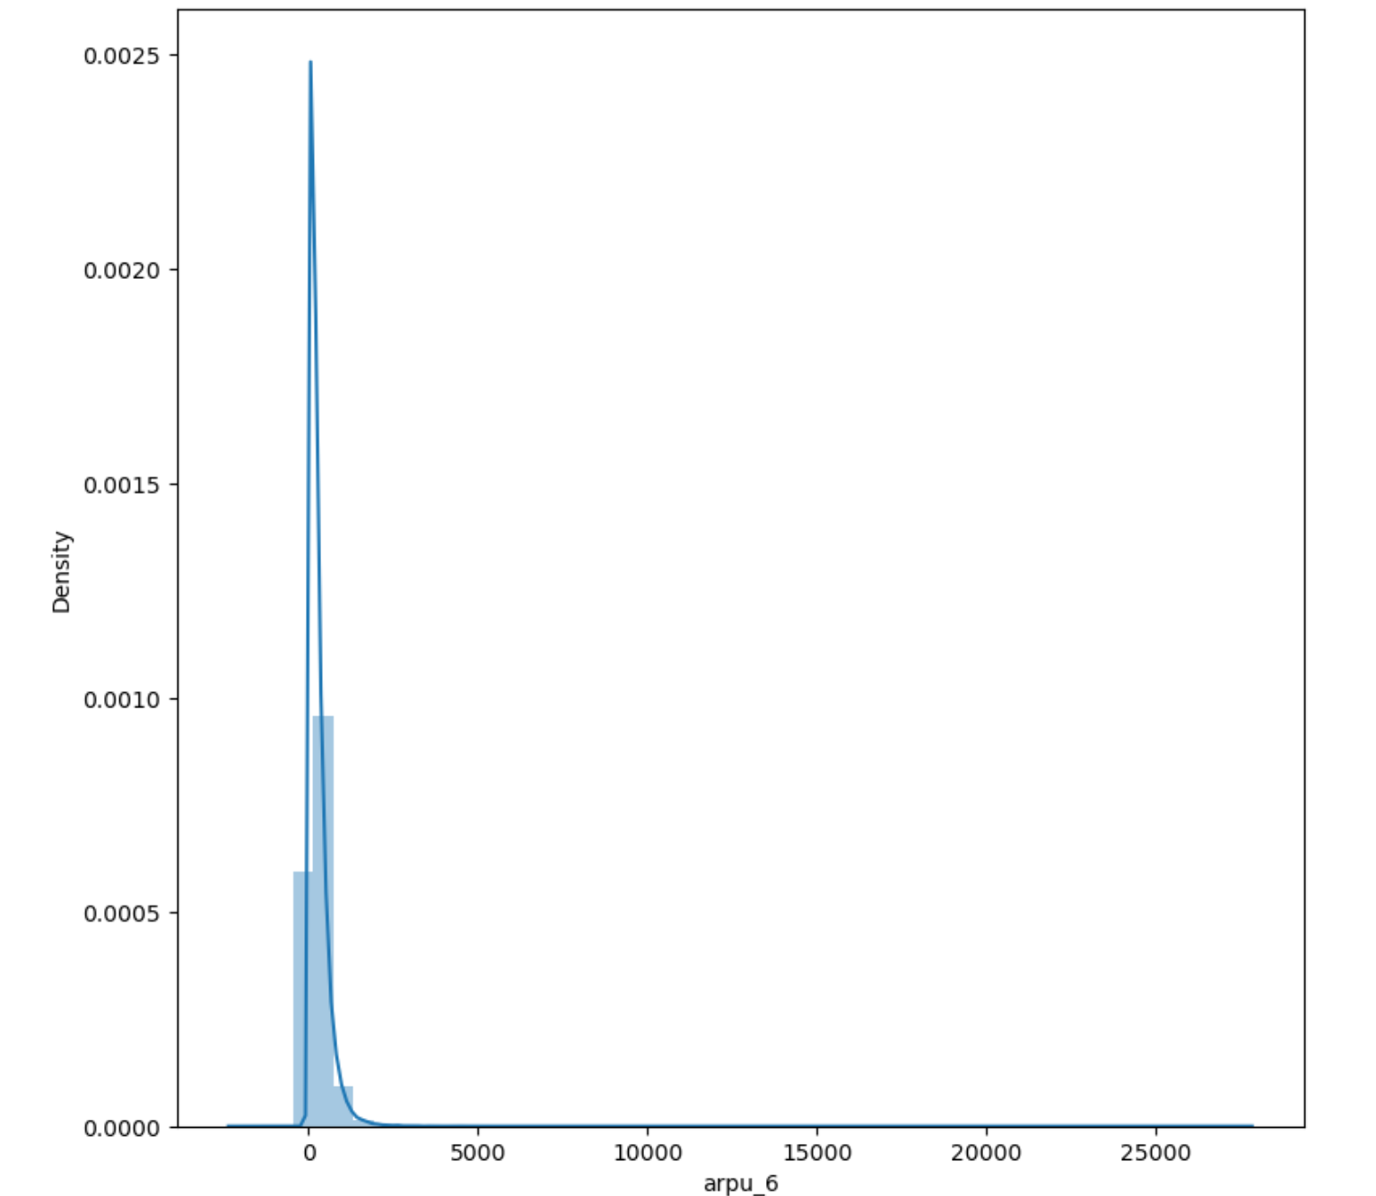
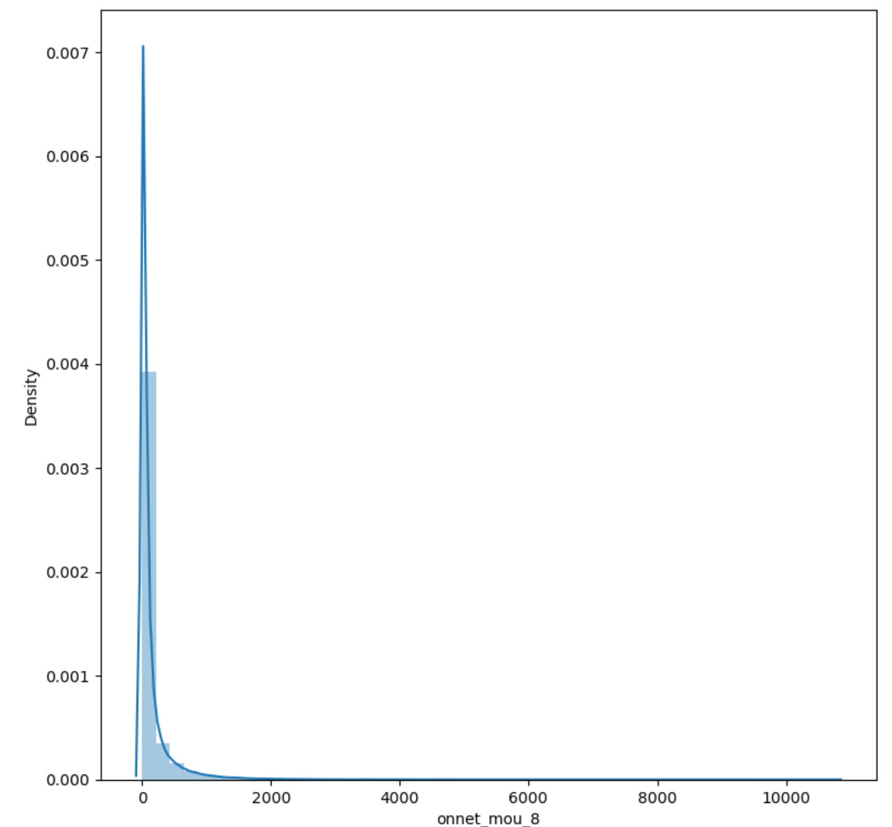
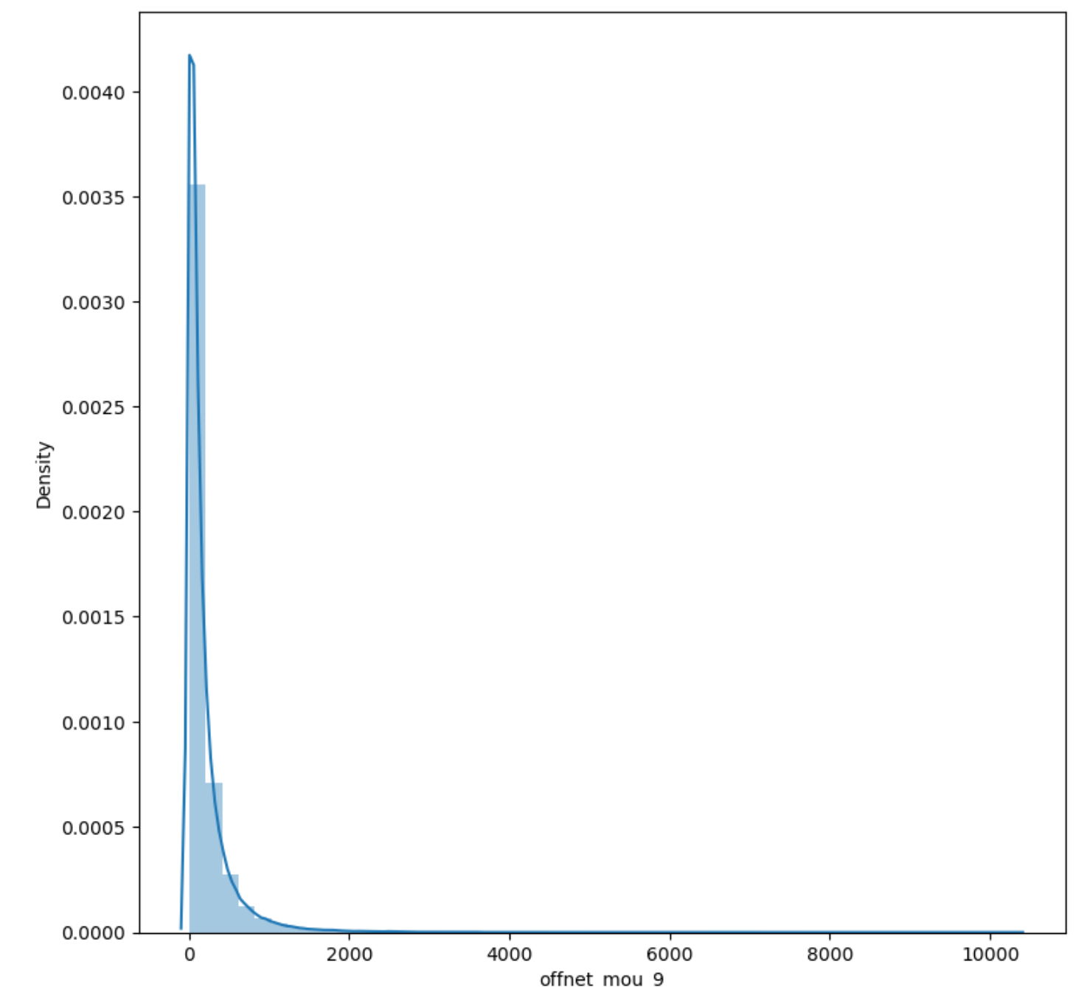
Exploratory Data Analysis
Univariate
Conclusion: Data is skewed to the left

Slide 5
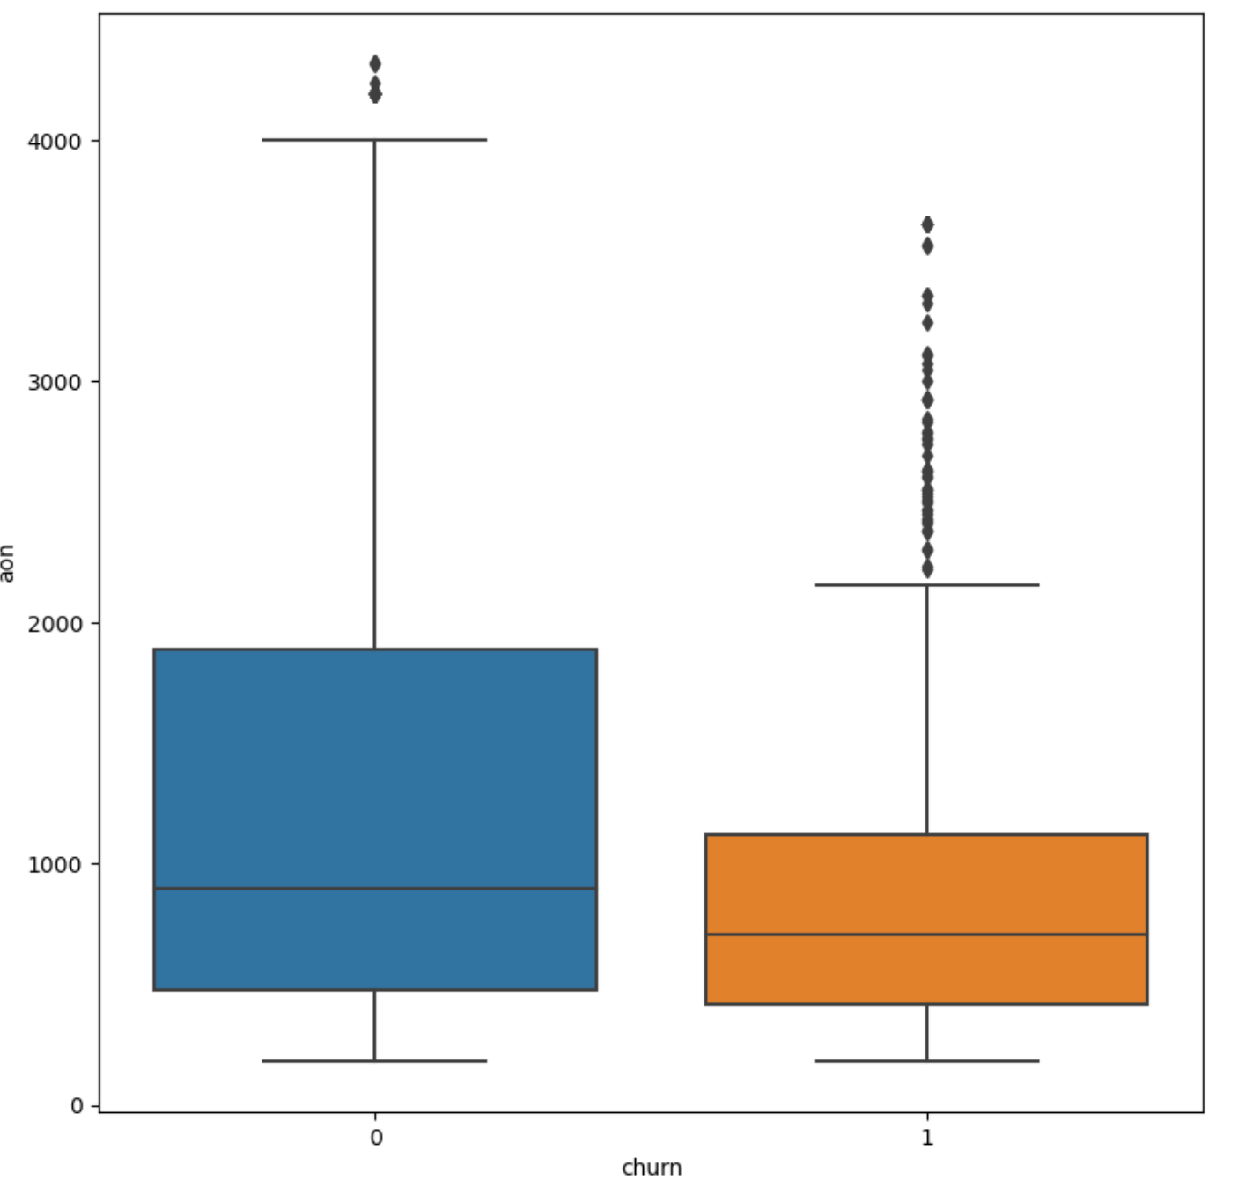
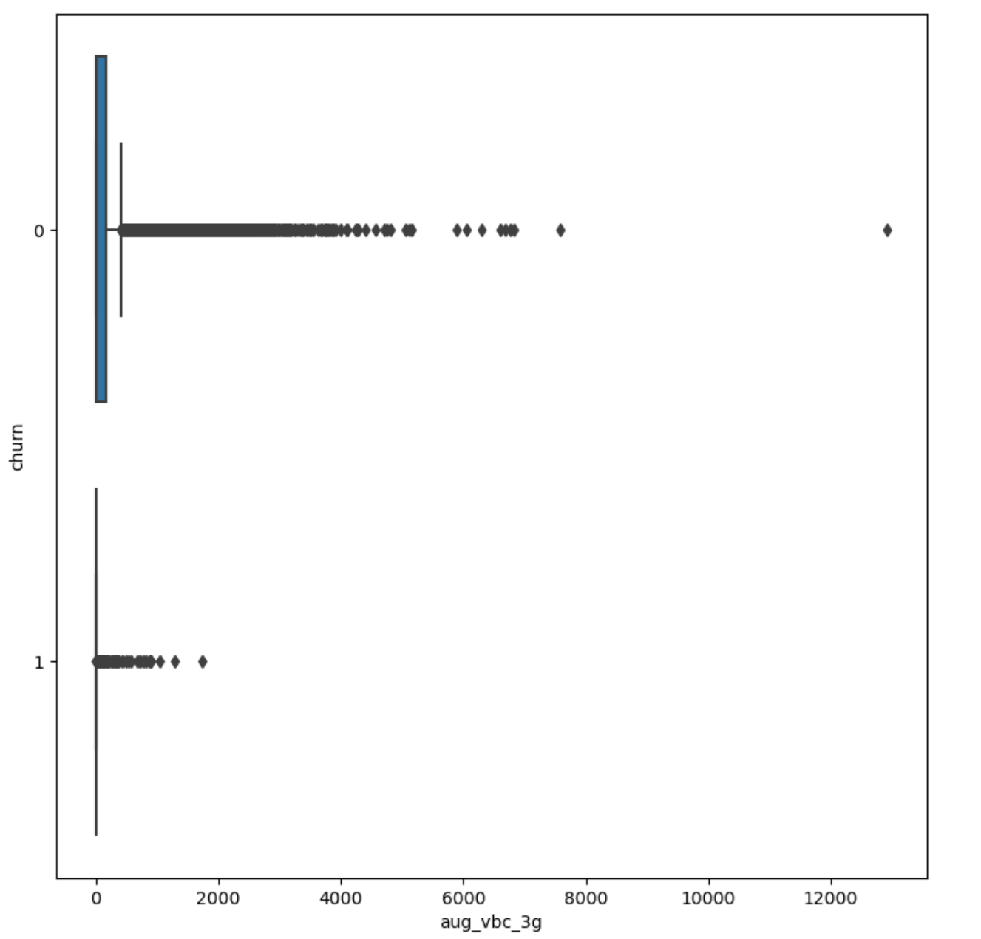
Exploratory Data Analysis
Bivariate
Conclusion: There are high percentile customers in the top quartile for non churn customers
Conclusion: Churn customers did not have any high valued VBC (volume based cost) in August as they are likely to churn in September

Slide 6
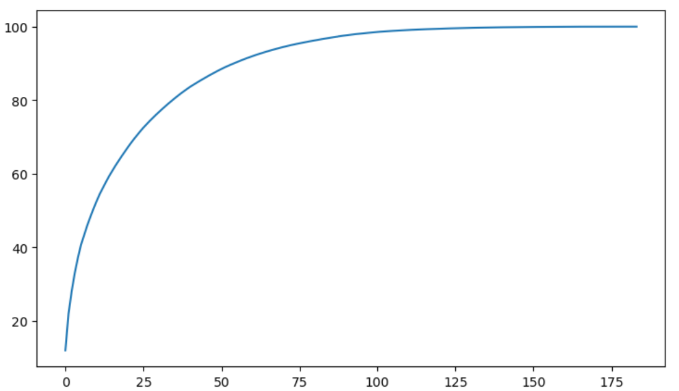
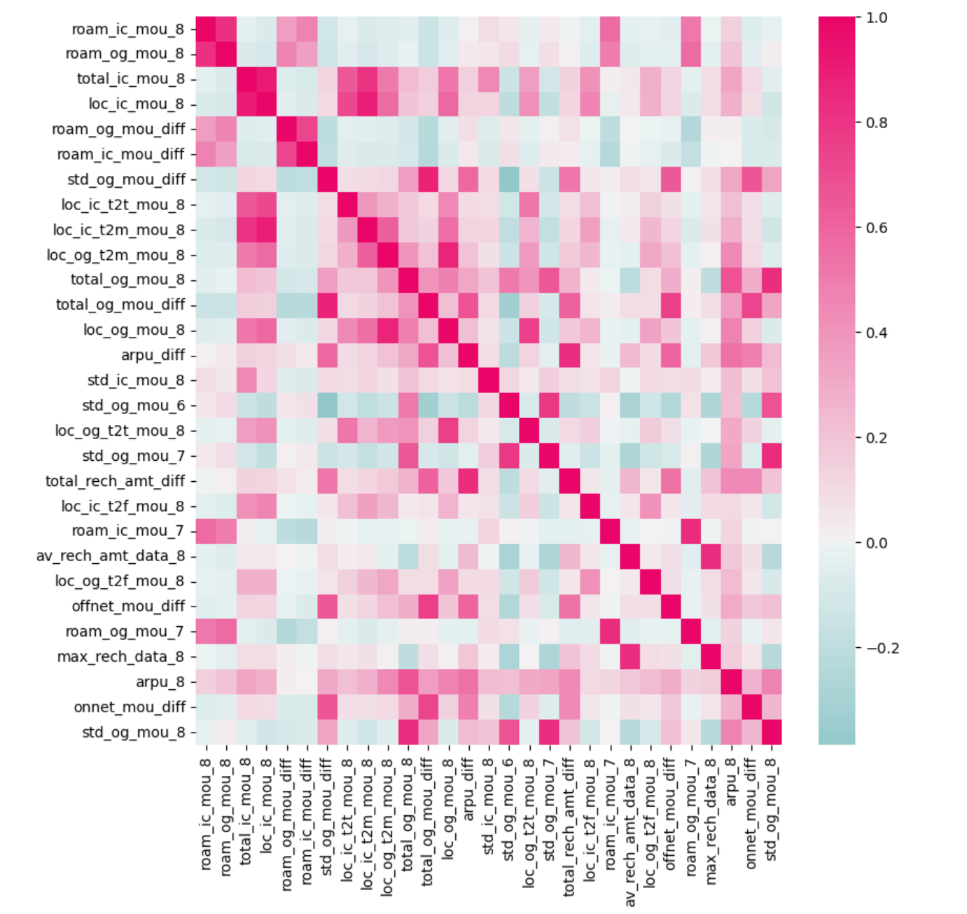
RANDOM FOREST
PCA & LOGISTIC REGRESSION
Feature variance plot
Feature selection graph
Logistic regression score returns a value of 84.6% on train data

Slide 7
EVALUATION ON TEST DATA
PCA & Logistic regression
Results of hyperparameter tuning : sensitivity - 86%, specificity – 86% AUC – 92%
Since the results are in line with the train data, overfitting can be ruled out
Random Forest
Results of hyperparameter tuning : sensitivity - 24%, specificity – 99% AUC – 97%
Since the results are in line with the train data, overfitting can be ruled out
Conclusion: Very poor sensitivity which is not good for our case study as we want to predict churns accurately. The best model is PCA along with Logistic regression

Slide 8
INSIGHTS AND STRATEGIES
1.Constant monitoring the roaming incoming and outgoing calls is necessary as it has positive effect on churn and also by giving some incentives when roaming calls increase, can increase chance of retaining the customer.
2.The difference of outgoing calls is having positive effect on churn so if the outgoing calls are reducing then we need to take care of the issue which is causing it may be network problems where as incoming has negative effect.
3.If Average revenue per month decrease for the user there is a high chance of churn as company can give some discounts to the user for increasing their spending
4.The company needs to focus on the STD and ISD rates. Perhaps, the rates are too high. Provide them with some kind of STD and ISD packages
5.To look into the issues stated above, it is desired that the telecom company collects customer query and complaint data and work on their services according to the needs of customers

